Slide 1
CS 4530: Fundamentals of Software Engineering Module 7.3: Agile Planning and Estimation
Adeel Bhutta, Joydeep Mitra and Mitch Wand
Khoury College of Computer Sciences
© 2025 Released under the CC BY-SA license

Slide 2
Learning Goals for this Lesson
At the end of this lesson, you should be able to
Describe how agile planning manages uncertainty by creating detailed plans only for the most immediate tasks
Explain how agile planning decomposes large projects into individual tasks that can be estimated
Understand the key artifacts and process steps in Scrum
Notes:
<read slide>

Slide 3
Requirements: Which to pick?
There are four knobs you can adjust when negotiating requirements:
Project scope
Project duration
Project quality
Project cost
Usually cost is most constrained: you have a budget to spend, and you have a headcount of developers to pay
Determining feasible scope, timeline and maximizing quality is the subject of much software engineering research
Notes:
Recall that in Module 1.2, in the context of requirements, we talked briefly about how it can be difficult to determine which requirements we could actually implement. Assuming that we are starting off on some new project, we might be negotiating the requirements for the project with a customer – having an opportunity to determine the scope and quality of a project, given a certain cost, and possibly given a certain duration.
(Maybe you did an example for user story generation like the snow plow app: that example would be nice to reference here – “Remember how many different features we came up with? How the heck do we pick some?”
Sometimes we might have flexibility to say “we need more developers”, but once you’re in the thick of developing some project it can be very hard to all of a sudden “add developers”, because they need to be onboarded, get up to speed, etc.
So, big big big big question I show do we determine a feasible scope, timeline and quality goals for our project? This topic is the focus for this lesson. This will become extremely relevant once students start to plan their projects!

Slide 4
Modern Software development is all about piecemeal growth
“piecemeal growth” is a core aspect of modern software engineering processes.
Engineers incrementally build systems that satisfy the complete set of requirements, and those requirements are being incrementally learned by product managers.

Slide 5
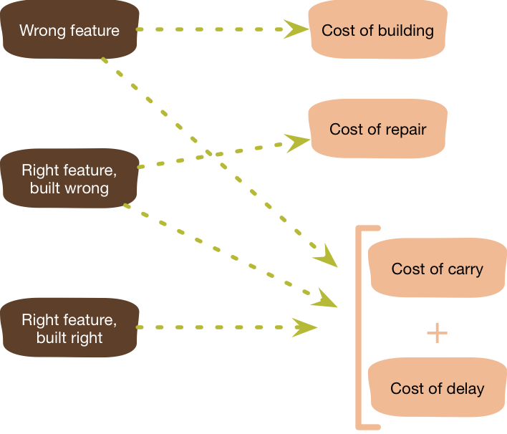
Agile Principles for Effective Planning: YAGNI
YAGNI – “You Aren’t Going To Need It”
Do not prematurely plan or implement features
Why? Uncertainty in what we actually need
Focus on prioritization, independent of estimation
Graphic: Martin Fowler
Notes:
With this lesson from meteorology in mind, let’s start to talk about the principles of agile planning. Recall that one of the goals of agile processes is to embrace uncertainty. The first principle is articulated by Martin Fowler in the acronym “YAGNI” (pronounced yag-knee).
If we go into a software project with the first principle “embrace change”, then we need to be willing to tolerate changes to our requirements that come from our users. We also need to embrace changes to our process and plans that come from our evolving understanding of what it is that we need to build, and how it should be built.
The YAGNI philosophy argues that pre-maturely planning and implementing features will almost inevitably result in wasted effort and a delayed schedule. Why? Because with a lot of software projects, both we and our customers may not know exactly what it is that is needed until we get closer to needing it. Consider the hurricane map: 5 days out, can we know what degree of preparations should be in Ohio or Indiana, which seem like they might be outside of the track of the storm, but could also be totally outside of the track of the storm?
One risk is that we end up building the totally wrong feature, in which case we wasted time planning and building that feature, plus the cost to continue to maintain and carry this feature that we now implemented, and the cost to delay other more important features. Building the feature in the wrong way also adds the cost to do it right, and even in the best case (where we built the feature correctly), we have still delayed other more important things from getting built

Slide 6
The product backlog is a key tool in agile planning and estimation
PlowTracker Product Backlog
List of user stories for the product
All entries should add value
No low level tasks
Item | Priority | Value
The driver’s interface should display unplowed streets | Essential | Required for MVP – drivers must know where to go
The driver’s interface should track which streets have been plowed | Essential | Required for MVP – informs rest of system what has been plowed
The city official’s internal interface should show estimated arrival times for plows | Desirable | City officials field thousands of complaint calls, expected to increase citizen satisfaction
The driver’s interface should show an optimized plowing route | Extension | Plowing will become more efficient, cuts fuel and labor costs
Members of the public should be able to see real-time plow status | Extension | Government transparency groups want this; it might reduce phone complaints
Notes:
The product backlog is a key tool in agile planning and estimation. The backlog lists all of the user stories for the product. In this case, I took a small sample of the user stories that we discussed (if you did the activity) for the plow tracker application.
Notice that the backlog includes not only the user stories, but a summary of their value, and a priority. Recall that a key aspect of requirements gathering is understanding the value that a specific story adds. Why? Because eventually we’ll end up with this product backlog, which might have hundreds of items on it. How can we practice YAGNI without knowing what that value is? By explicitly stating the value that a user story adds and tracking this in the backlog, it is easier to have a conversation with the customer, where we reassess the priority of different user stories given shifting priorities.
For example, in the four user stories shown in this fictious product backlog, we can see that there are two tasks that are core to the very key minimum viable product (MVP) that we can deliver: we need to show drivers what has not been plowed, and track the streets that get plowed. There are surely other features needed for an MVP of our PlowTracker, too, but they don’t fit on this slide.
The third user story has a medium priority, and focuses on providing an interface to allow city officials to project when different streets will be plowed, so that they can have better data to answer complaints when people call in. There may be uncertainty in this user story. While from a technical perspective it might be easy to say “oh yes, we can build another map display quite easily”, the customer might re-evaluate the value that this feature adds. For example, perhaps after this project was announced, a government transparency group put pressure on the mayor’s office to allow any member of the public to view live plow arrival estimates for any point in the system, a user story that had low priority originally – the plan was to provide access only through an internal system for city officials at first. However, based on pressure from this citizen group, now the mayor really wants to see this public interface available immediately – the priority should be elevated. Something will need to shift though, how do we still deliver the product? By examining the value that each user story adds, we might be able to come to the conclusion that we can drop the priority of the internal interface (medium), and raise the priority of the public view.

Slide 7
An agile project should re-prioritize tasks to meet changing conditions
PlowTracker Product Backlog
List of user stories for the product
All entries should add value
No low level tasks
Items are prioritized
A living document
Item | Priority | Value
The driver’s interface should display unplowed streets | Essential | Required for MVP – drivers must know where to go
The driver’s interface should track which streets have been plowed | Essential | Required for MVP – informs rest of system what has been plowed
The city official’s internal interface should show estimated arrival times for plows | Extension | City officials field thousands of complaint calls, expected to increase citizen satisfaction
The driver’s interface should show an optimized plowing route | Extension | Plowing will become more efficient, cuts fuel and labor costs
Members of the public should be able to see real-time plow status | Essential | Government transparency groups want this; it might reduce phone complaints
Notes:
Then, our product backlog might look more like this: we can easily determine that the internal interface should be lowered in terms of priority, and the public interface should be elevated. The backlog is a living document: an artifact that we can use to spark conversations with our teammates, and with our customers. The backlog tracks the current state of our overall development goals, their priorities, and their values.
Notice how YAGNI helped save us from inadvertently making a technical decision that it was easiest to implement the city official’s internal view at the same time as the driver’s interface. We might have started to implement that (since we would need it later, anyway, right?), but then found that we didn’t need it yet, instead needed the public interface more urgently, and are not going to be able to deliver it as quickly because we still haven’t finished implementing the driver’s interface because we wasted time on the city official’s interface.

Slide 8
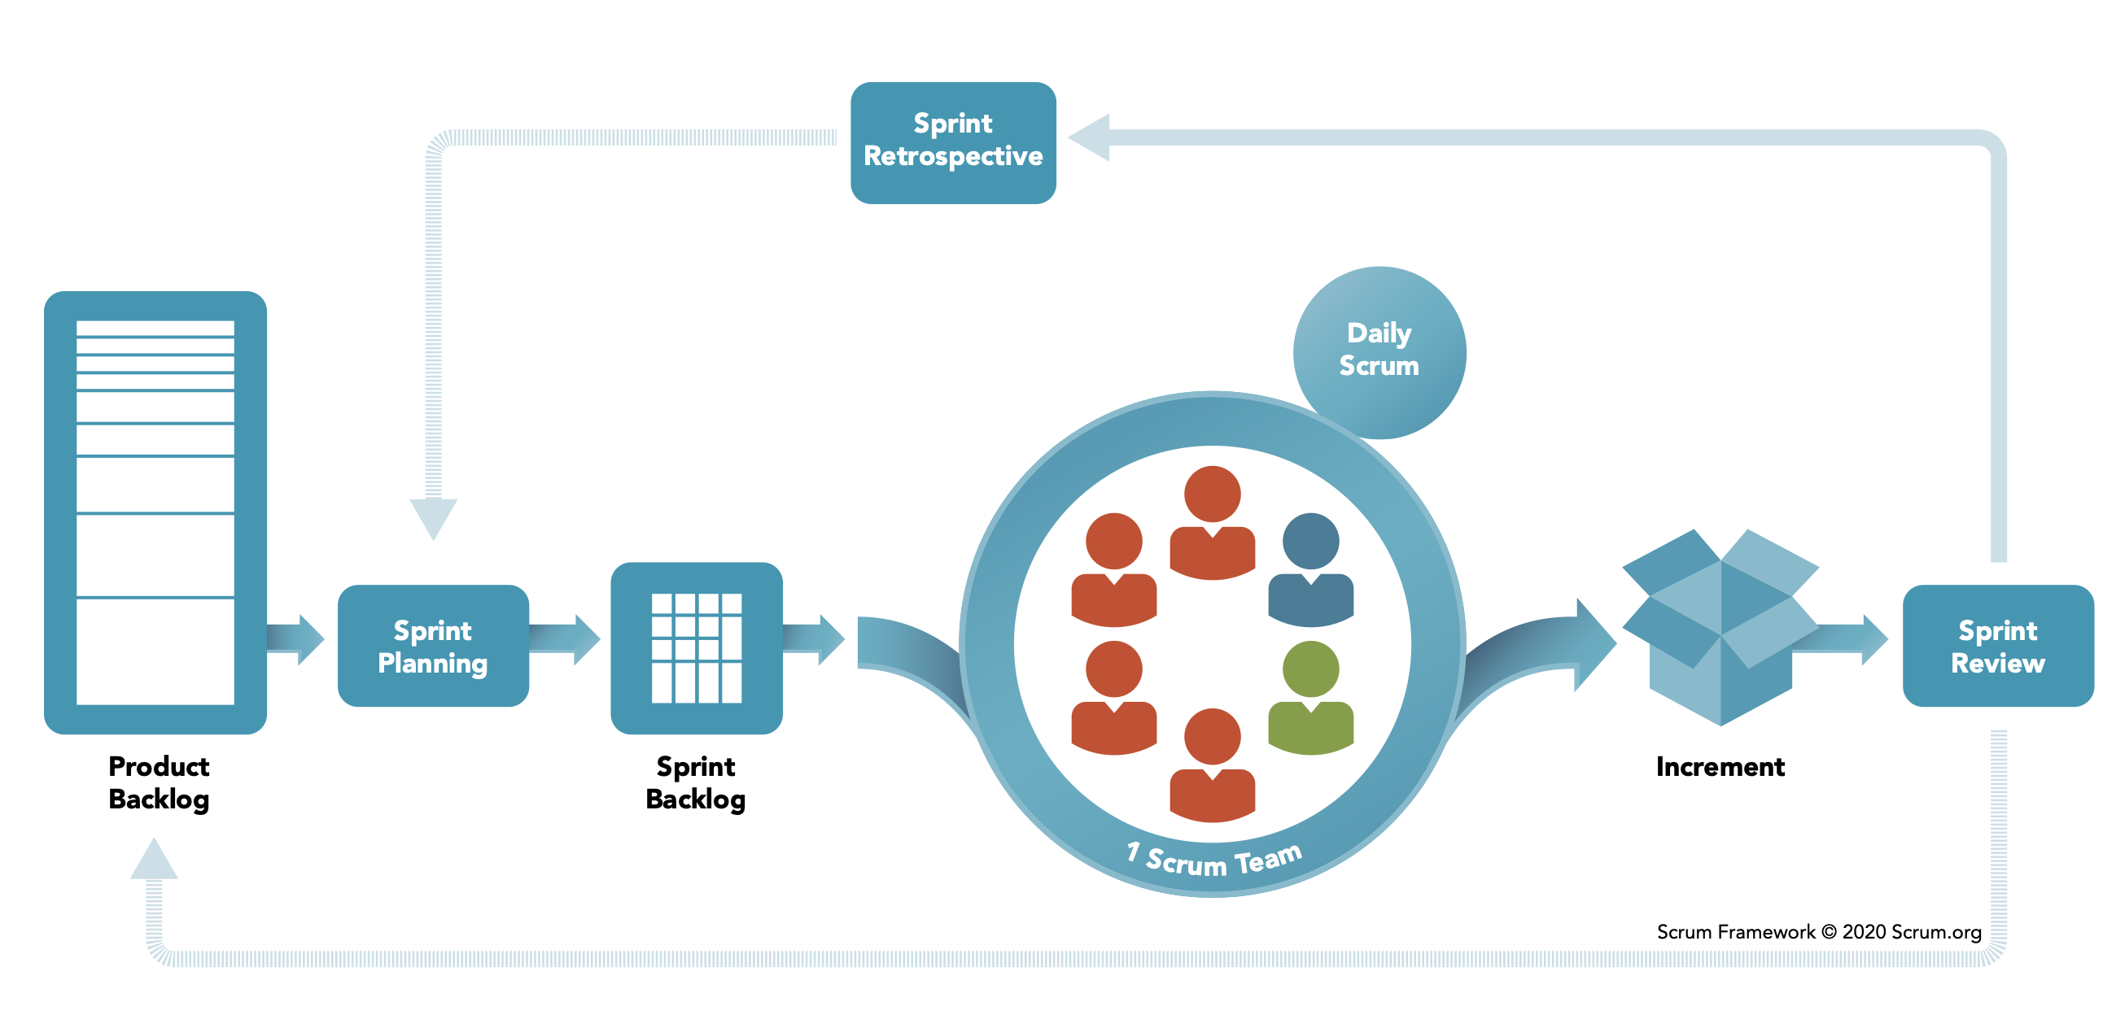
Scrum is the most common approach to organizing agile projects.
Notes:
So, how do we go from this product backlog to some delivered software? Scrum is the most common approach to organizing agile projects. There are a few key vocabulary terms that you need to understand in order to talk about scrum, which hopefully won’t be too hard to understand. We’ve already seen one of the artifacts that are used in the scrum process: the product backlog.
Using this product backlog as our starting point, scrum organizes our development activities into sprints, which are time-boxed (fixed duration). Most commonly, sprints are 2 weeks, but it’s also not unusual to see a 30-day sprint. In scrum, we focus most of our planning activities on each of these sprints
The first phase of a sprint is planning: a meeting with the whole team. For a 2-week sprint this meeting is usually capped at 4 hours, and for a 30-day sprint, capped at 8 hours. In the first half of the meeting, the team decides on what can be done in the sprint, setting goals. Then the team decides on how to do that work, creating detailed tasks that will take one day or less.
During the sprint, there are short, “Daily Scrum” meetings – timeboxed to 15 minutes.
At the end, there is a sprint review of what was done, including key stakeholders and users, and a retrospective of what went well or could be improved.
Do not plan the next sprint until the last one is complete.
Implementing an effective scrum process is, however, much harder than reading this slide is – it helps to have a deep understanding of the agile principles to get into the right mindset. In particular, it’s important to reflect on the way that your team can inspect its performance and adapt to change. We’ll discuss each of these key steps, and continue to use the PlowTracker app as a running example.

Slide 9
Planning a Sprint
Select user stories for the sprint based on priority and value
Decompose stories into detailed tasks
Estimate duration of each task (max 1 day each)
Time-boxed meeting – don’t make every decision here
Include non-story tasks as needed (e.g. quality improvements, knowledge acquisition)
Notes:
When we plan for a sprint, we start by selecting user stories that we would like to implement, and decompose those stories into tasks.
Discuss prioritization: how do you determine what to do first? Hopefully based on mutual understanding of the value of each story. This is again why it is so important to talk about what the “value” of some feature is.
Then we decompose the stories into individual tasks. We don’t estimate the duration of each story directly, but instead do a work breakdown first, and then estimate the duration of each task to come up with a rough timeline for an overall story/feature.
The entire team comes together for this planning meeting, so it is important to not waste time. If you don’t plan everything in detail, that’s OK, because your agile principles tell you to make decisions as late as possible – some planning will always be done at the last responsible moment. Remember what this is in response to: the waterfall “plan everything in advance” model. This is not that kind of meeting.
When planning a sprint, there may also be a variety of other tasks that need to happen to support the overall product development that do not directly tie to a user story in your product backlog. For example:
Bug fixes
More general quality improvements: performance, security, other non-functional requirements
Knowledge acquisition: learning more about the domain, or learning more about specialized technologies that you need

Slide 10
Planning a Sprint Backlog
Sprint Focus:
“The driver’s interface should display unplowed streets”
“The driver’s interface should track which streets have been plowed”
Sprint tasks:
Tasks for API design
Work out the interface for CRUD on plowed streets
Tasks for app development
Design the interface for viewing unplowed streets
Create the map interface that shows streets in the city
Fetch unplowed streets from API and update the map
Update the API with current location while plowing in progress
Tasks for backend development
Determine how to model and store plowed street data
Implement tests for expected API behavior
Implement API to mark street as plowed
Implement API to fetch unplowed streets
Notes:
Here’s an example of a sprint backlog that decomposes two of the plowtracker user stories into individual tasks. This list of tasks may not be fully exhaustive. Important to note that they are grouped in some logical manner that might help us organize who works on what, and that there are design, test, and implementation tasks in here.
Note: no estimation yet. We can’t estimate until we have the tasks. If you don’t have a good understanding of what work actually needs to be done, it’s pretty hard to come up with a reasonable estimate. How can we estimate how long each of these tasks will take?

Slide 11

Estimating Task Time
Collaborative team process:
Estimate how long each task will take (hard)
Estimate relative size of each task (easier)
Notes:
None of us is as smart as all of us, particularly when it comes to thinking through the complexities and details of development tasks: how long will something really take? Estimation is a team process, best performed by the group who will be doing the work: that is, the development team who will be performing the tasks should be the ones who make the estimate.
Once you get your team together, there are two high–level approaches to take for estimation.
First, you can try to estimate the time that each task will take, assigning say, 30 minutes, one or two hours, a day, or a week to a task. Estimating tasks at this level can be really hard: good estimates come from experience, and even a seasoned, experienced developer may not be able to come to a good estimate for a new project.
An alternative approach which is more common is to avoid estimating the actual hours that some task will take, and instead measuring the relative complexity/size of each task. Some tasks are small, others are medium, others are large. This strategy is often called “T-shirt sizing”. Let’s see an example of how one of these meetings might go.

Slide 12
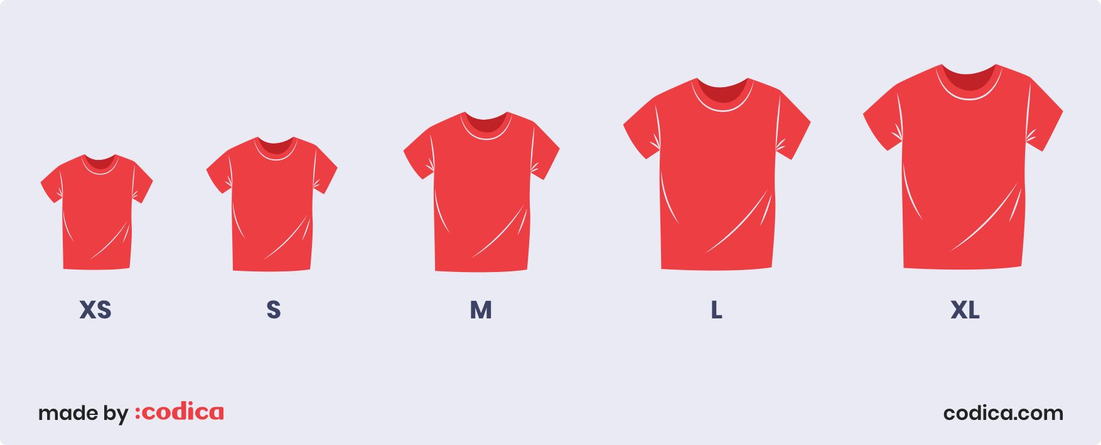
Estimating with T-Shirt Sizes
Notes:
XS are things we really know how to do quite quickly
S are a bit bigger. We’ve done this exact task before, it takes more than a few minutes, but we know it can be done with ease
M – maybe things we have experience with, but not that exact task.
L– challenging task that will need investigation.
XL – huge amount of work and complexity.
What we like about t-shirt sizes is that they are relative: we define how hard something will be based on what we’ve done before. We also like that they do not directly imply time estimates, because the time estimates are likely to be under-estimates anyway.

Slide 13
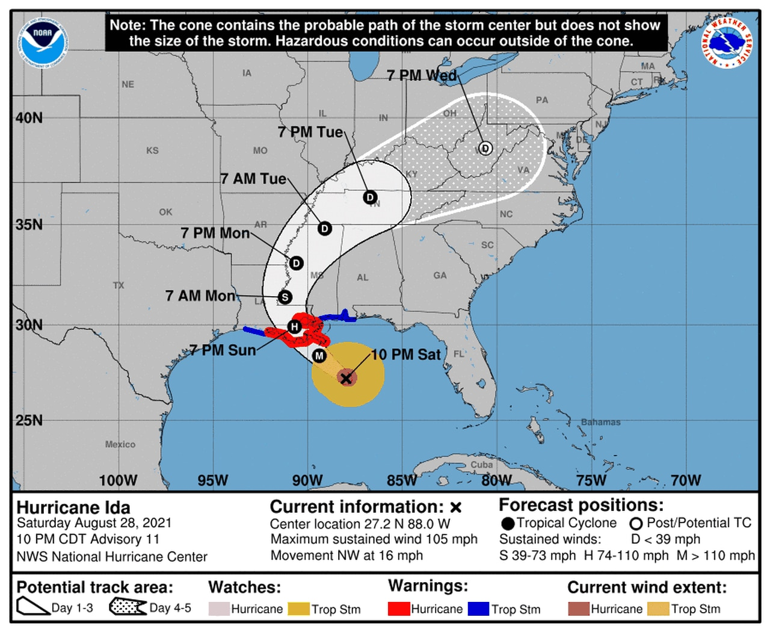
Lesson from Meteorology: Uncertainty in Estimation
Notes:
In some ways, predicting how long it will take to build some software project is like predicting the path of a hurricane: With state-of-the-art computer models, we can predict with reasonable certainty where the center of a hurricane will move to over the coming hours. If you have lived in an area that is subject to hurricanes, you may be familiar with maps like this. This hurricane track map shows a “cone of uncertainty” of where the center of the storm will move to.
This map was generated by the NWS National Hurricane Center at 10pm on Saturday Aug 28, 2021. You can see that for the next 48 hours it’s pretty clear which direction it’s going, and the size of the track is quite narrow. As time progresses, the quality of the estimate decreases, and the cone gets wider. Ultimately for days 4-5, the cone is shown with a different texture to make clear that this prediction is even less precise. The map even comes with a disclosure that it is only predicting the CENTER of the storm’s path, and not the scope of the impact.
It is hard to estimate exactly where a software project will be after a few months, but like a hurricane model, as we get more data, our estimates can improve in quality.

Slide 14
Example: Estimating with T-Shirt Sizes
Discussion: Would you accept these estimates? Why? What factors should the team consider? Are tasks missing?
Task | Size | Rationale
Work out the interface for CRUD on plowed streets | Medium | We’ve designed similar APIs before, there will likely be some new aspects, but it will not be too hard. It will require coordination.
Design the interface for viewing unplowed streets | Small | The client has already shared mockups of what they want
Create the map interface that shows streets in the city | Large | We haven’t worked with mapping APIs before; maybe we should decompose this into smaller tasks, there is risk here.
Fetch unplowed streets from API and update the map | Medium | We think that this should be easy, it’s just patching a few components together, but don’t yet know enough about how the map will be implemented to know for sure how hard this is.
Update the API with current location while plowing in progress | Small | We know exactly what API call to make here, and how to fetch location, it’s easy
Notes:
Let’s return to our sprint plan for PlowTracker, and see how the team ended up. (Read slide. Remember that this is a fictitious app, there are more tasks not shown on this slide, we don’t know the background of the team, and there is no claim that this is a “perfect” estimation. We don’t want to make “perfect” estimates anyway, and hopefully there is enough here that it can start some discussion amongst the class).
One clear task that should be created (from reading the sizes and rationales) is that the “large” task of “create map interface” needs to be broken down. There are other tasks that depend on knowing how to make the map part work, and if the team isn’t confident in how to do this, it’s better to break it down. How do we know that this is “large” and not “extra-large” or “extra-extra-large”? How will we understand if progress is being made on this task? (see suggestion on next slide)

Slide 15
Planning helps us find what we don’t know
Task | Size | Rationale
Research OpenStreetMap API and examples of its usage | Small | We’ve learned how to use other APIs before. This one looks well documented, and spending a few hours looking at examples will probably go a long way.
Create OpenStreetMap prototype, showing a static map with streets | Small | A quick internet search shows plenty of examples, this should be easy to adapt
Create the map interface that shows streets in the city | Medium | Once we’ve built a throwaway prototype that shows the city map, we can leverage that knowledge to build the map in our app
Notes:
As a result of this planning process, the team might have decided to create some explicit knowledge acquisition tasks: doing some research on a potential API to use for displaying the map (openstreetmap), and expliclty building a throwaway prototype: a trivial interface that doesn’t satisfy the requirements of your plowtracker app, but gets you experience working with openstreetmap. Then, the actual task of putting the map into our app should be more attainable.
[Good spot to pause for activity: What are the user stories? What are the implementation tasks?]

Slide 16
”Sprint 0” Tasks to Help Estimate Stories
Find resources to gain more experience about a technology or about a problem domain
Create prototypes that you can throw away
Consider having multiple developers implement different approaches
Create load tests/simulations to identify the performance limits of technology or architecture
Learn just enough to make a responsible estimate
Notes:
What if we are trying this for the first time. Maybe you are planning out your team project. In the context of the project in the second half of the semester, you might find that there are some technologies that you want to work with, but have no idea how to estimate how hard it is. Starting a truly “greenfield” project (no existing code or design) will involve even more of these issues, particularly if your solution space is vast (what language do we use? What off-the-shelf components can we reuse?). Thankfully, for the term project you won’t be starting entirely from scratch, because you are building on an existing codebase, and you will have completed three sprints to get up to speed on it (HW2, HW3, HW4).
A general strategy to improve estimations is to create a “sprint 0” that focuses on knowledge-generation techniques to help you learn what you need to do. Here are some examples of those kinds of tasks and questions that they might help answer. (read slide)
Note that the goal here is NOT to learn _everything_ that you need to know in order to complete the project: if you did that, you would be doing the waterfall thing. Instead, the goal is to learn just enough to create a responsible estimate. Not a perfect one. Not an illinformed one. Just a “responsible” estimate.

Slide 17
The Daily Scrum meeting is the key
Notes:
Now that we have our sprint planned and the sprint backlogged defined, it’s time to start to actually do the work and complete the tasks. During the sprint, we have a recurring meeting called the Daily Scrum.

Slide 18
Daily Scrum is also called “stand up”
15 minutes maximum “stand up” meeting
What have I done?
What am I working on?
What am I stuck on/need help on?
Conversation focuses on goals:
Transparency between team members
Encourage adaptation
Notes:
(Read questions)
Why?
Provides a framework for team to share information. What are people working on? How are we aligned with delivering value?
To the extent to which we are “agile”, we need to be able to adapt. We can adapt when we share what’s working and what’s not working, and then can work together to try to fix it. This is not the meeting where the decision of “how to fix it” is determined, but is the meeting that elicits the fact that a fix needs to be constructed.

Slide 19
Sprint Review and Retrospective
Sprint Review:
Provide a working demo
What did we get done?
What value did we deliver?
Sprint Retrospective
What went well?
What could we have done better?
If incidents occurred: conduct a blameless postmortem
Provides an opportunity to reflect on overall project velocity
Notes:
At the end of our sprint, there are two additional meetings, a review and a retrospective.
Remember, sprint duration is fixed: it is possible that not everything planned gets done, and that is OK.
Sprint review – demonstrate the value that was delivered: what tasks did we get done, what stories are complete, what actually works?
Sprint retrospective – how do we improve our process? Key part of agile is continuous process improvement. Look at all sorts of things:
How did our process, and our tools, work for us (or against us)
How did our relationships with other teams develop?
What could make us more productive, or help us enjoy our work more?
Example - Avoid repeated overtime: it is symptomatic of process problems, and you likely need to decide to change your time estimate, your scope, or inevitably you will reduce quality
Everyone’s biggest question with estimation is: “When will the feature (or entire project) be delivered?”
This is a hard question to answer, and Agile offers no silver bullet here. This process provides us with a regular opportunity to reflect on the overall project velocity, however. If we estimate each remaining user story as a t-shirt size, how many large, medium, and smalls are left? We can calculate metrics of how quickly we tend to finish those tasks… But it’s all still just an estimate! :/
One related questions often is: Why are projects late? Here are some reasons:
* an unrealistic deadline established by someone outside the software development group
* changing customer requirements that are not reflected in schedule changes;
* an honest underestimate of the amount of effort and/or the number of resources that will be required to do the job;
* predictable and/or unpredictable risks that were not considered when the project commenced;
* technical difficulties that could not have been foreseen in advance;
* human difficulties that could not have been foreseen in advance;
* miscommunication among project staff that results in delays;
* a failure by project management to recognize that the project is falling behind schedule and a lack of action to correct the problem

Slide 20
Project and You
Best practices to adopt:
Use project management / planning software (like Github project, JIRA) to track your work
Setup your project repo and work in independent branches, merge to main branch frequently
Setup communication channel for the team (and your TA)
Do regular and frequent check-ins with your team.
Help each other (or ask for help) when needed
Do a sprint review (with TA) and learn lessons from retrospectives
Fill out honest peer-evaluations and try to resolve team issues quickly
Notes:
At the end of our sprint, there are two additional meetings, a review and a retrospective.
Remember, sprint duration is fixed: it is possible that not everything planned gets done, and that is OK.
Sprint review – demonstrate the value that was delivered: what tasks did we get done, what stories are complete, what actually works?
Sprint retrospective – how do we improve our process? Key part of agile is continuous process improvement. Look at all sorts of things:
How did our process, and our tools, work for us (or against us)
How did our relationships with other teams develop?
What could make us more productive, or help us enjoy our work more?
Example - Avoid repeated overtime: it is symptomatic of process problems, and you likely need to decide to change your time estimate, your scope, or inevitably you will reduce quality
Everyone’s biggest question with estimation is: “When will the feature (or entire project) be delivered?”
This is a hard question to answer, and Agile offers no silver bullet here. This process provides us with a regular opportunity to reflect on the overall project velocity, however. If we estimate each remaining user story as a t-shirt size, how many large, medium, and smalls are left? We can calculate metrics of how quickly we tend to finish those tasks… But it’s all still just an estimate! :/
One related questions often is: Why are projects late? Here are some reasons:
* an unrealistic deadline established by someone outside the software development group
* changing customer requirements that are not reflected in schedule changes;
* an honest underestimate of the amount of effort and/or the number of resources that will be required to do the job;
* predictable and/or unpredictable risks that were not considered when the project commenced;
* technical difficulties that could not have been foreseen in advance;
* human difficulties that could not have been foreseen in advance;
* miscommunication among project staff that results in delays;
* a failure by project management to recognize that the project is falling behind schedule and a lack of action to correct the problem

Slide 21
Learning Goals for this Lesson
At the end of this lesson, you should be able to
Describe how agile planning manages uncertainty by creating detailed plans only for the most immediate tasks
Explain how agile planning decomposes large projects into individual tasks that can be estimated
Understand the key artifacts and process steps in Scrum
Notes:
<read slide>

